Slide 1
How to Manage Your Erasmus+ KA1 Project Successfully?

Slide 2

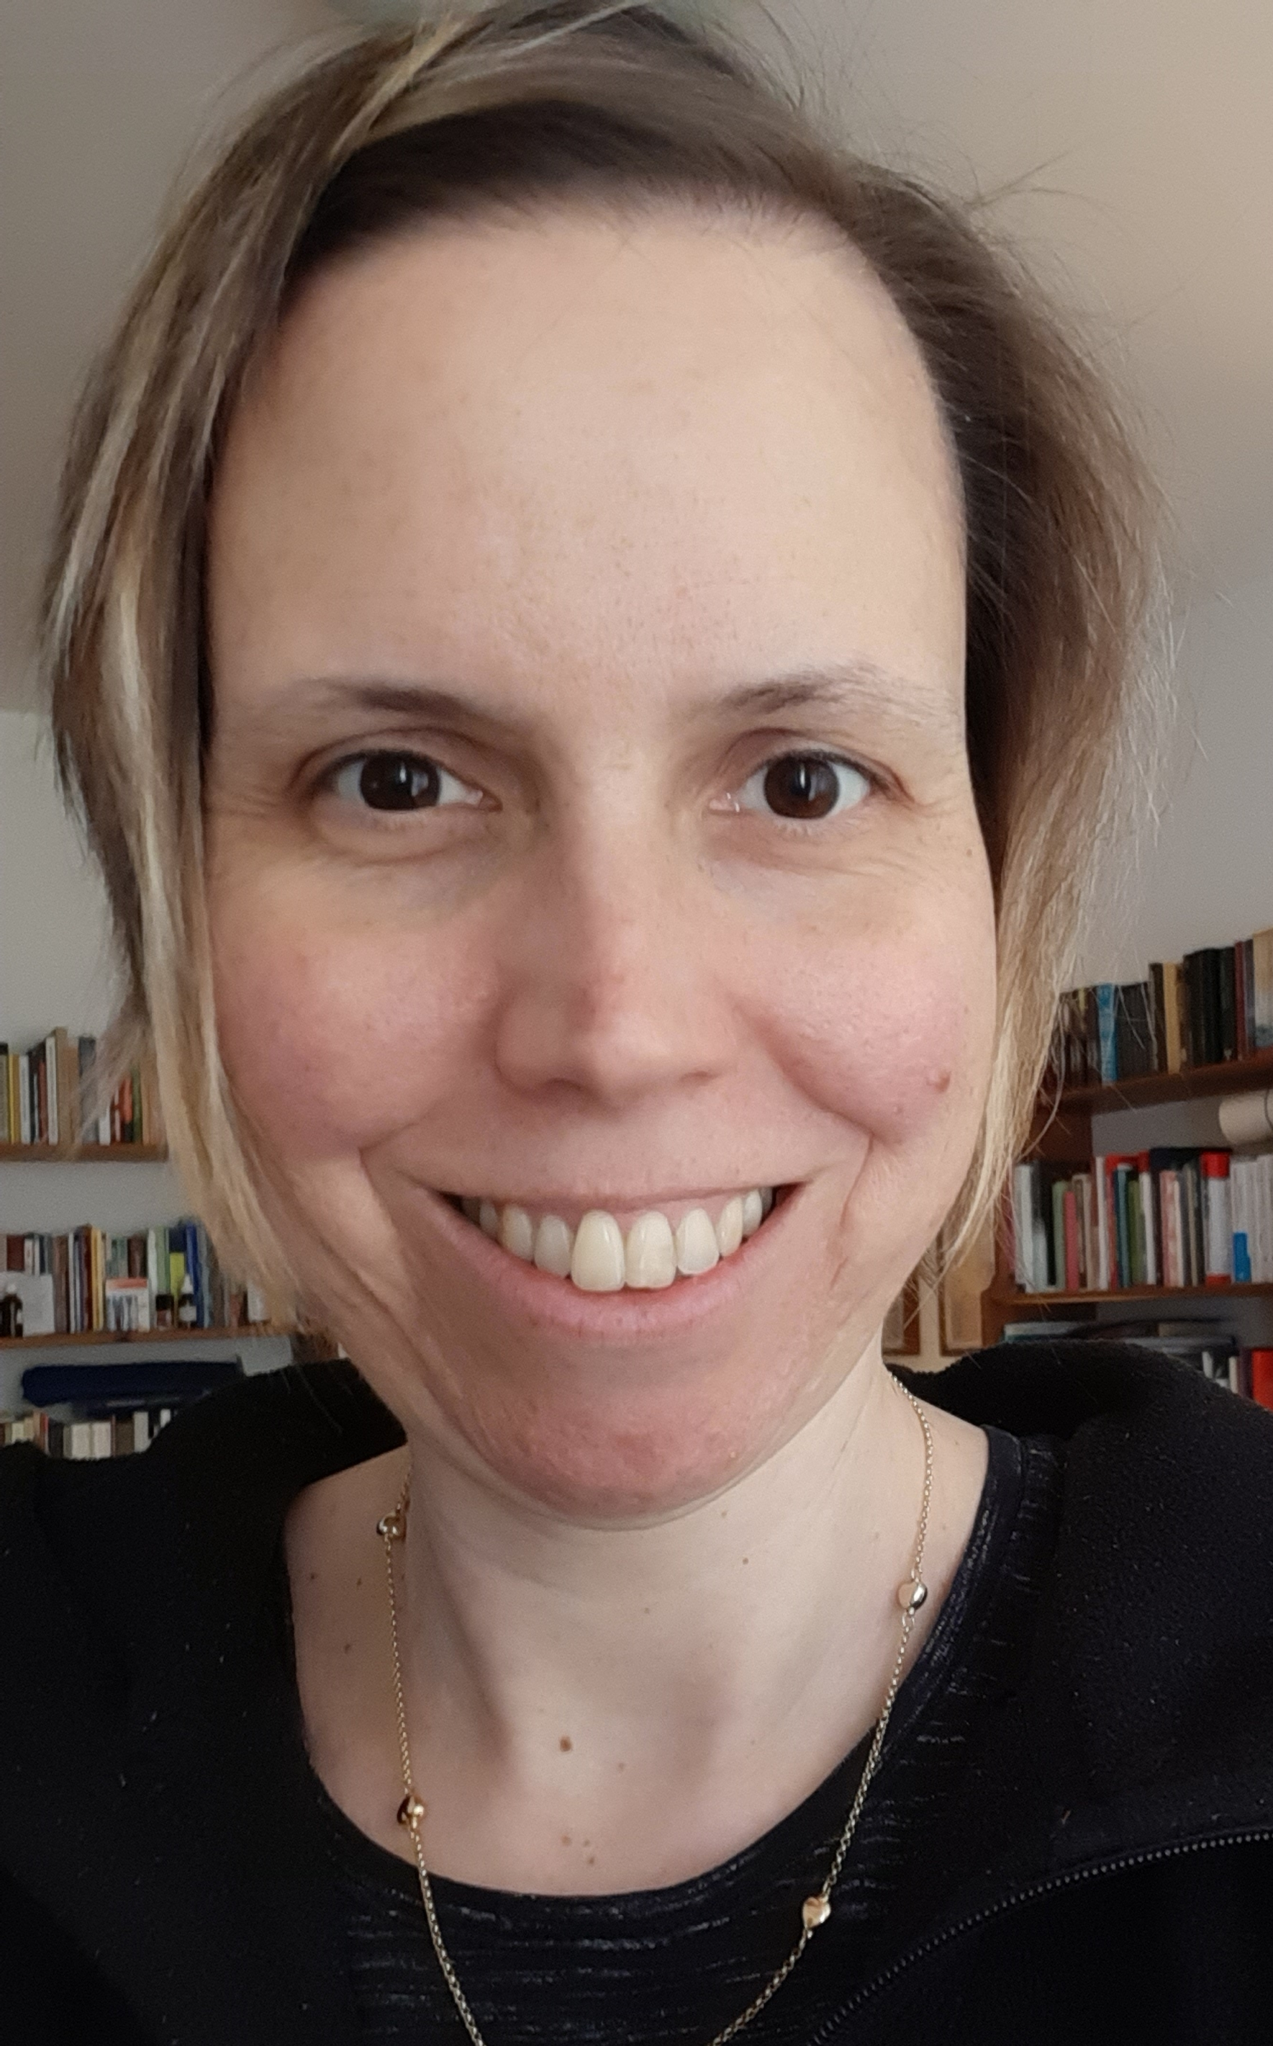


Former staff member at the Hungarian National Agency
ESZTER KOVACS
Erasmus+ expert cooperating with supporting institutions
Language teacher at a Hungarian secondary school
Qualified coach

Slide 3
01
02
03
Rapid date
Your favourite animal
Your favourite place in your country
One thing that you definitely don’t want to miss during the upcoming week

Slide 4
Learning outcomes of the course
How to manage your KA1 project successfully?
https://www.babylon.academy/portfolio/erasmus-for-coordinators-and-staff-how-to-manage-your-ka1-project-successfully/#toggle-id-3

Slide 5
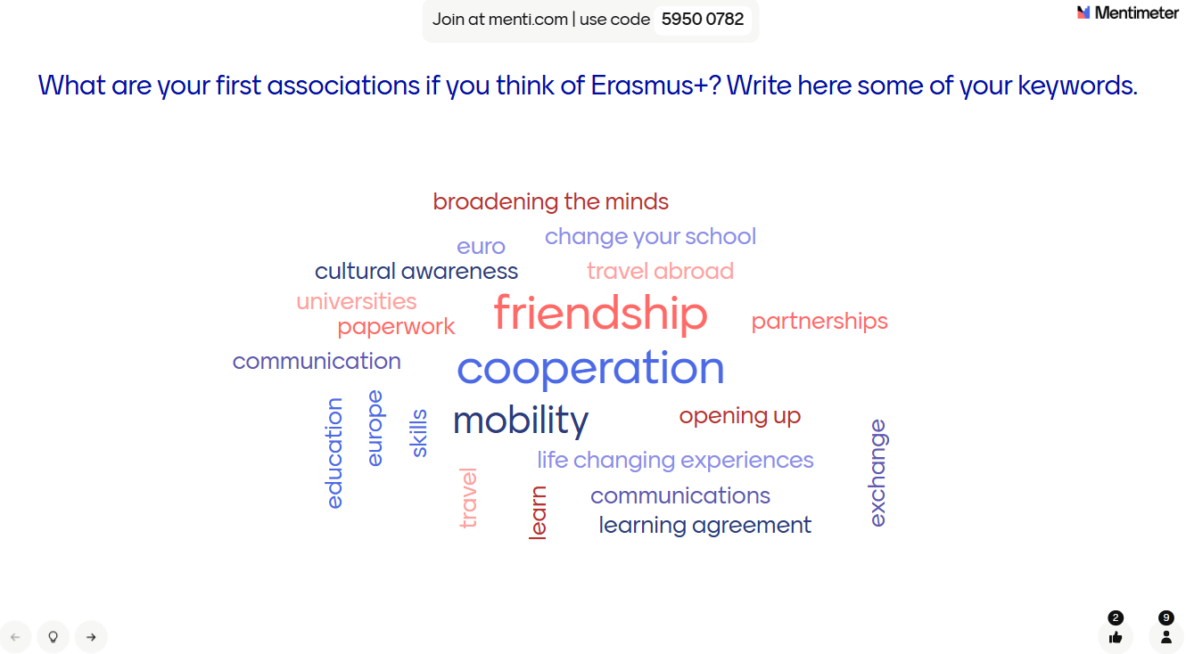

Slide 6




KA1 in School Education - OBJECTIVES
Strengthening the European dimension of teaching and learning
Increasing the quality of teaching and learning in school education
Contributing to the creation of the European Education Area

Slide 7




Programme priorities
Environment and sustainability
Inclusion and diversity
Digital transformation in education
Participation in democratic life

Slide 8
Possible mobility project types
Short-term project
Accredited project
Don’t have any project yet

Slide 9
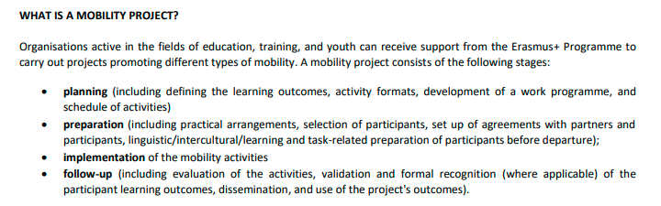
Stages of a mobility project (Guide p. 39)

Slide 10
Setting up roles and responsibilities
Reporting
Partner search abroad
Dissemination
Needs analysis
Involving the school management
Defining project activities
Defining the project aims
Sharing results
Workplan with a timeline
Budget planning
Evaluation
Communication and team building
Participating in a project management course
Defining the project outcomes
Identifying the target group
Involving the school maintaining authority
Monitoring
Sharing experiences
Risk management

Slide 11
OBJECTIVE – THE AIM (Guide p. 102)
Increasing the quality of teaching and learning in school education
Strengthening the European dimension of teaching and learning
• supporting professional development of teachers, school leaders and other school staff;
• promoting the use of new technologies and innovative teaching methods;
• improving language learning and language diversity in schools;
• supporting the sharing and transfer of best practices in teaching and school development;
• making learning mobility available for everyone
• promoting values of diversity, tolerance, and democratic participation
• promoting knowledge about shared European heritage and diversity
• development of professional networks
Contributing to the creation of the European Education Area
• fostering recognition of learning outcomes of pupils and staff in mobility periods abroad – Europass Mob. Certificate

Slide 12

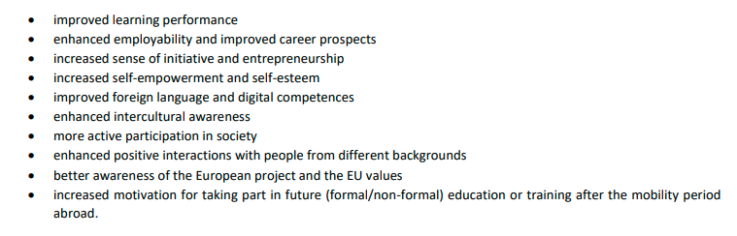
LEARNING OUTCOME –
THE CHANGE (Guide p. 38)

Slide 13

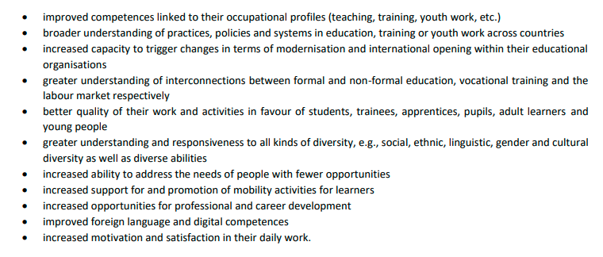
LEARNING OUTCOME –
THE CHANGE (Guide p. 38)

Slide 14
MOBILITY ACTIVITY – THE TOOL
Job shadowing
(2-60 days)
Teaching / training assignment (2-365 days)
Courses and trainings (2-10 days)
Group mobility of pupils (2-30 days)
Short-term mobility of pupils (10-29 days)
Long-term mobility of pupils (30-365 days)
Invited experts
(2-60 days)
Hosting teachers and educators in training (10-365 days)

Slide 15
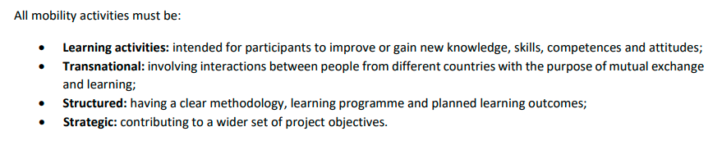
ALL MOBILITY ACTIVITIES MUST BE.. (Guide p. 105)
…linked to the learning outcomes and project objectives.

