Slide 1
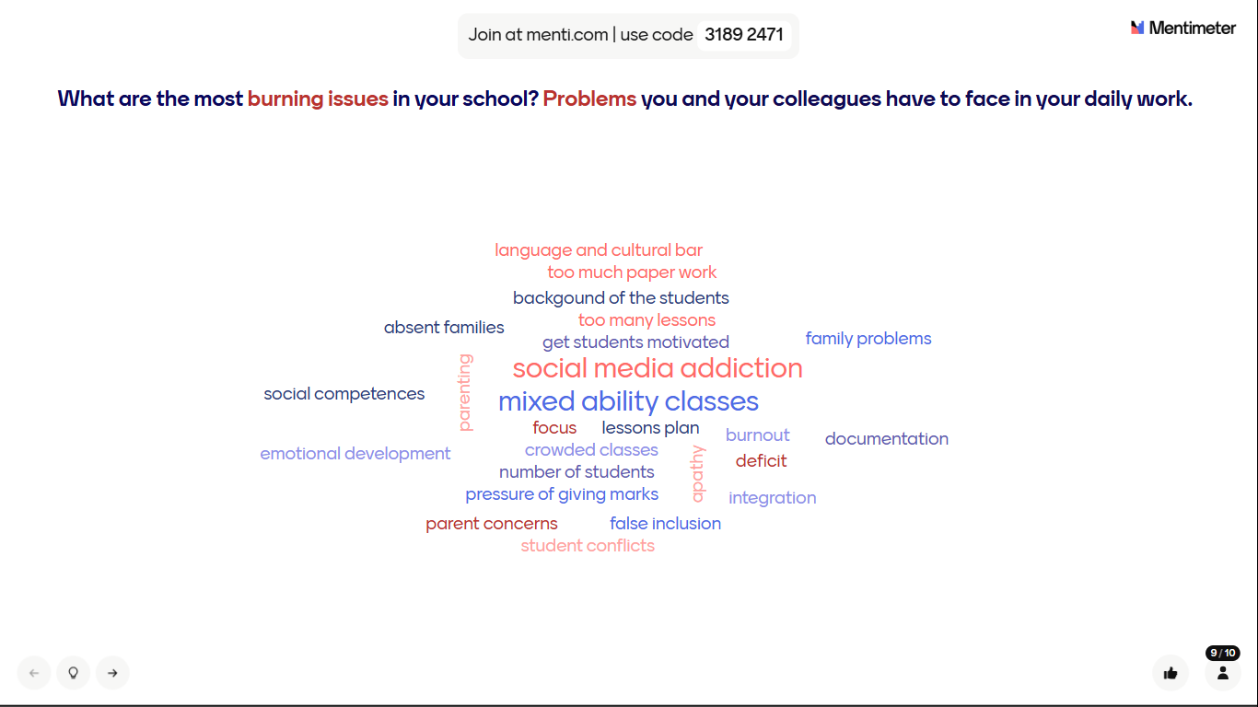

Slide 2
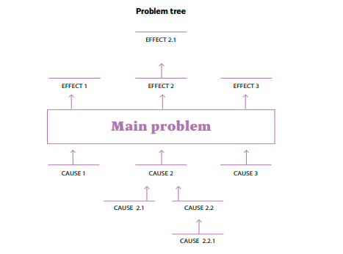

PROBLEM ANALYIS
→ Which is the issue you are able to have an impact on?
→ How could you turn this problem into an objective?

Slide 3
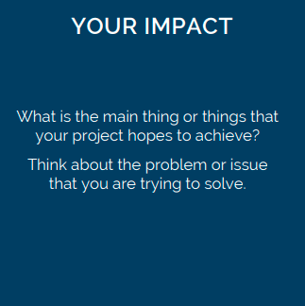
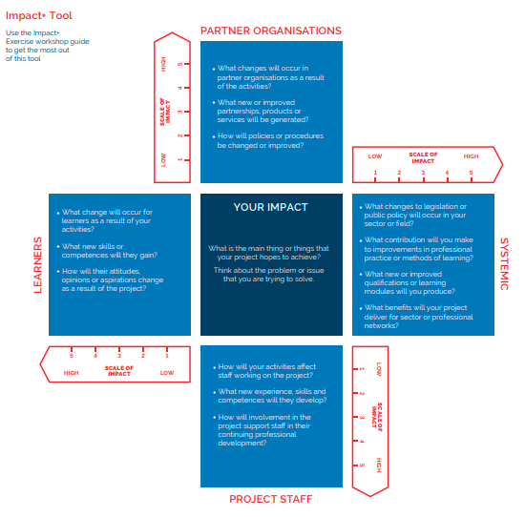

Slide 4
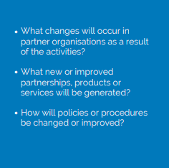
Impact on your school

Slide 5


Slide 6
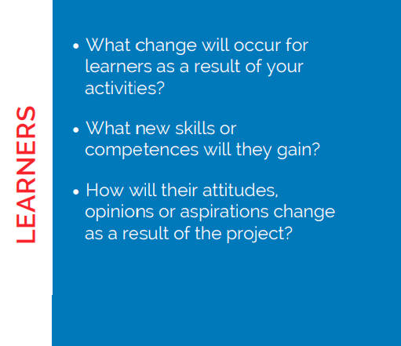

Slide 7
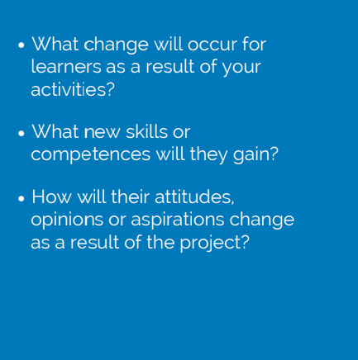
Teachers

Slide 8

Any other target group?

Slide 9
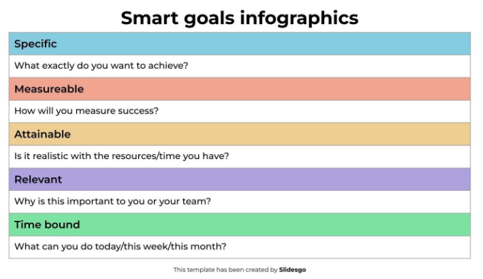

Slide 10
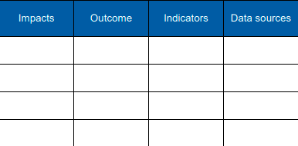

Slide 11
Useful materials
https://drive.google.com/drive/folders/1tQdzIMH8H1jYkY2Uzh_CI5MKqg_rcwv5

