Slide 1



Project = learning process
Who is the learner?

Slide 2
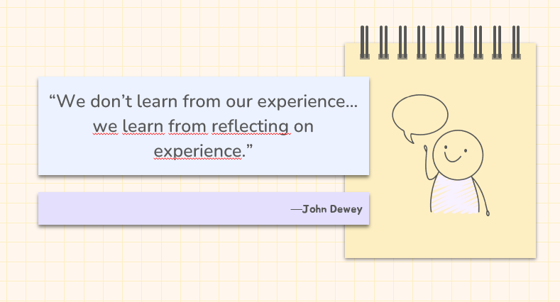

Slide 3
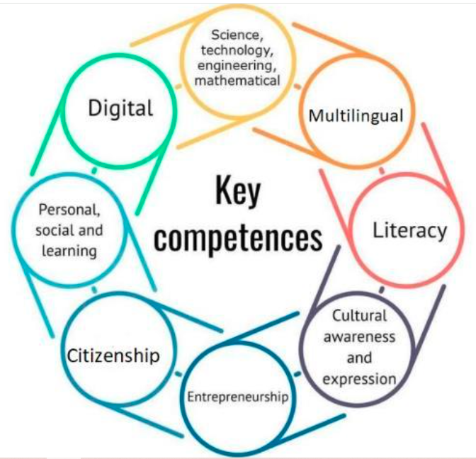
Key competences
https://education.ec.europa.eu/focus-topics/improving-quality/key-competences

Slide 4

Learning outcomes in the context of Competences
Knowledge:
The cognitive domain. Theoretical or factual knowledge
Autonomy
Skill:
The psychomotor domain. The ability to apply theoretical knowledge in different contexts
Competence
Attitude: The affective domain. The emotions and attitudes to learning

Slide 5
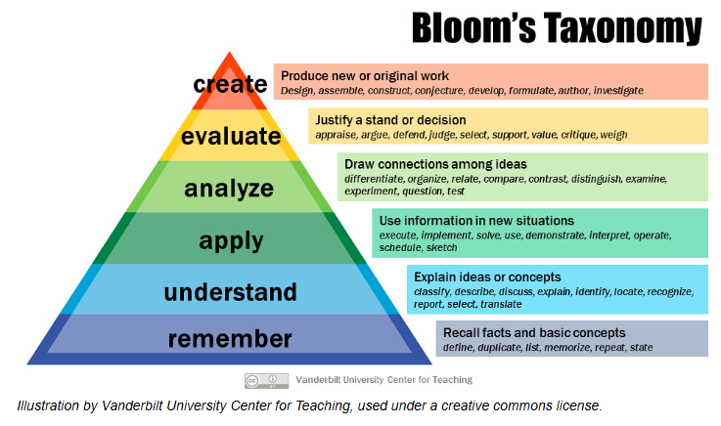
https://spark.scu.edu.au/kb/tl/design/bloom-s-taxonomy

Slide 6
Learning outcomes
A learner-centered approach that defines formal and informal learning pathways from the perspective of outcomes.
Statements about what the student knows, understands, is capable of, and what attitudes they have after completing a learning process.

Slide 7
Possible learning outcomes of a mobility
Students will discover the environmental treasures of their own town and the town where the host school is located,
They will identify local environmental problems in the host community,
They will work together to develop suggestions for possible solutions.
They will develop their foreign language skills.
They will learn and experience local costums and become open to other people and cultures.

Slide 8
Activities of a mobility
The mobility will last for five days. As part of the introductory program, students will give presentations about their own institutions and visit an environmental photo exhibition prepared by local students on local environmental issues. There will also be professional fieldwork: hydropower station, forestry activities. Sports, cultural, and gastronomic programs are also planned. The students will participate in regular school lessons., especially science classes. The students will be accommodated by host families.

Slide 9
Activity | Knowledge | Skill | Attitude | (Autonomy)
Prepare a presentation (presenting their own school)
Visit an exhibition on local environmental issues
Professional fieldwork: hydropower station, forestry activities
Sport, cultural and gastronomic programs
School lessons (science)
Being accommodated by families

Slide 10
Monitoring and evaluation of learning outcomes
Students will discover the environmental treasures of their own town and the town where the host school is located,
They will work with their peers to identify local environmental problems in the host community,
They will work together to develop suggestions for possible solutions
They will develop their foreign language skills.
They will learn and experience local costums and become open to other people and cultures.
Do these outcomes overlap with the program planned before?

